Slide 1
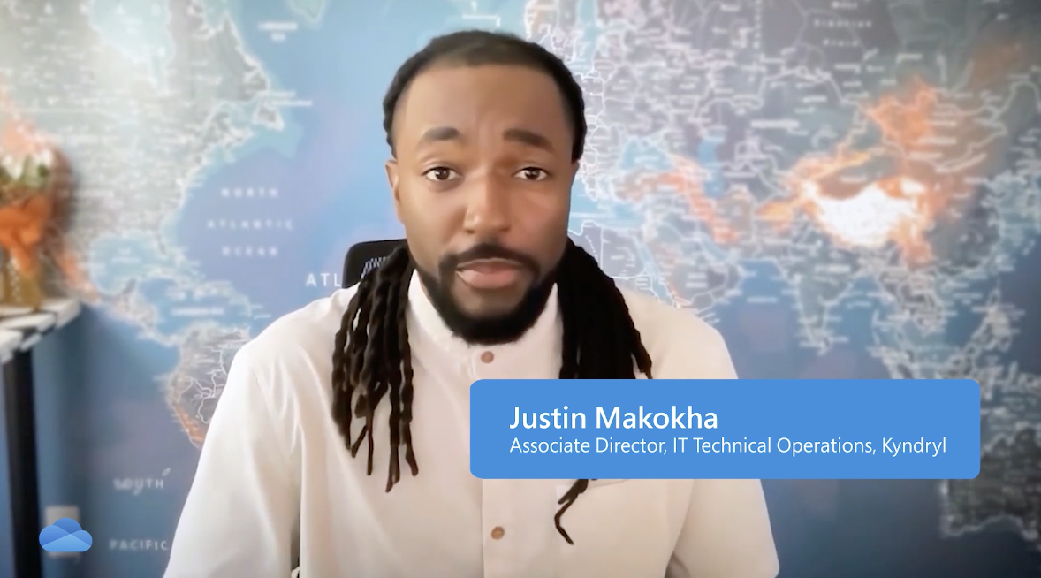

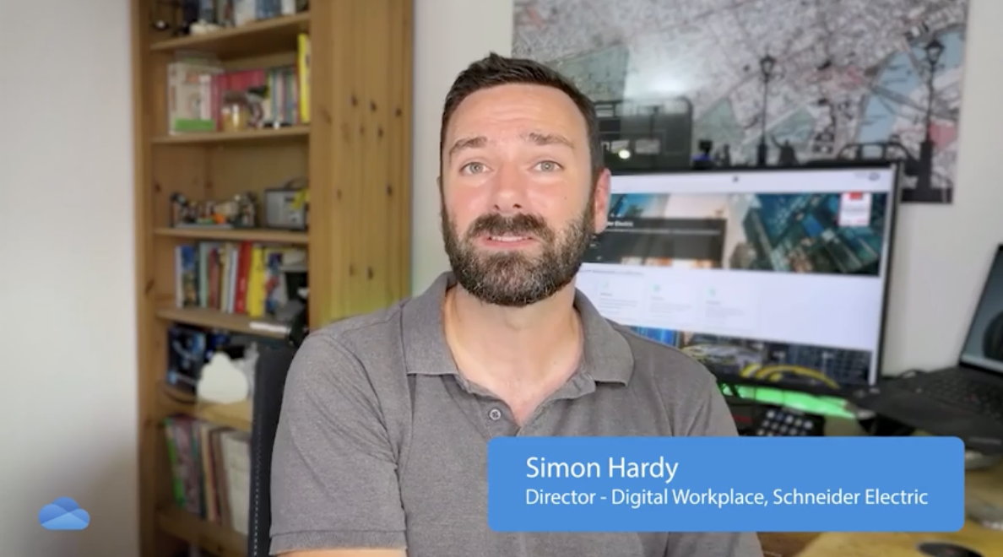
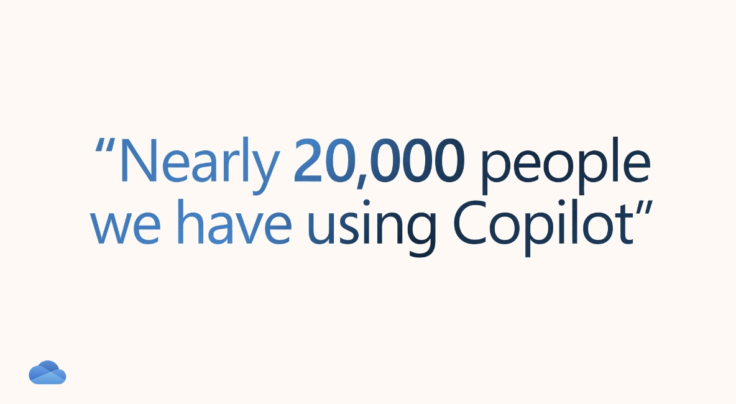
Customer Stories for Event Success
Microsoft approached Affirma to produce compelling customer stories in preparation for an upcoming event. They needed high-quality video production to meet their brand standards, a quick turnaround to ensure readiness, and a focus on three pre-identified customers whose stories aligned with their event goals.
Our Work
Refined interview questions to draw out the most compelling customer insights
Managed scheduling, conducted and recorded virtual interviews with the identified customers
Gathered relevant assets, including Figma screens and B-roll footage, to enrich the stories
Produced three customer story videos, each tailored to showcase SharePoint’s benefits
Created shorter sizzle videos for each story to generate buzz and engagement during the event
The Result
Successfully showcased three high-quality customer stories aligned with event goals
Generated excitement and engagement at the event through sizzle videos, driving audience interest in the full stories
Effectively highlighted SharePoint’s features and their impact on customer success, reinforcing the client’s value proposition
Here’s what the client had to say about working with us

